Slide 1

Final year Capstone Project – Final Review
Web Application Security Testing: A NIDS-based Penetration Testing Approach
By
SHREYA MALSHETTY |  | ID No.: 20211CCS0061
JAYALAKSHMI D |  | ID No : 20211CCS0064
CHAITHRA BANGER |  | ID No : 20211CCS0114
SRUJANA MNAJUNATH |  | ID No : 20211CCS0116
Under the supervision of
Dr. Sharmasth Vali Y
Associate Professor
Department of Computer Science Engineering
January ,2025

Slide 2
Content
1. Plagiarism check of project report.
2. Plagiarism check of research paper.
3. Paper publication acknowledgement.
5.Timeline by Gantt Chart
6.Acknowledgement

Slide 3
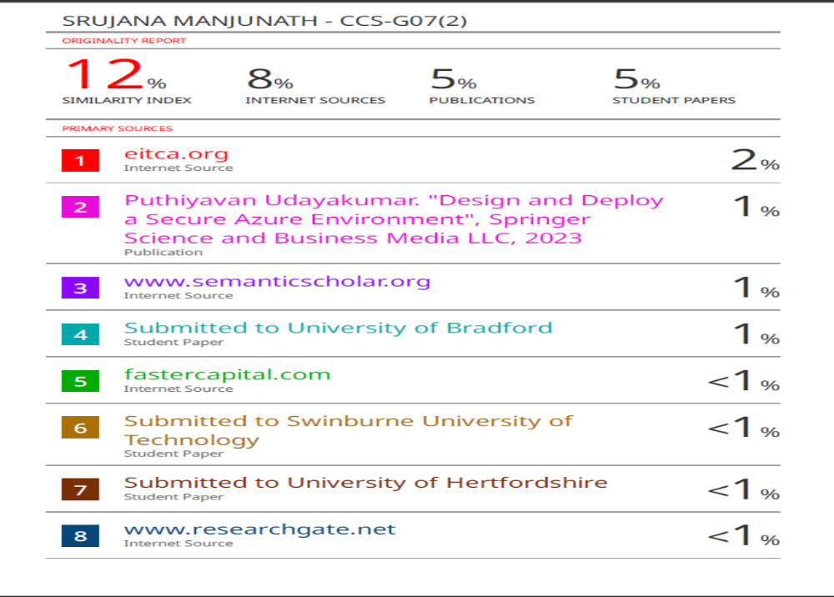
Plagiarism Check of Project Report

Slide 4
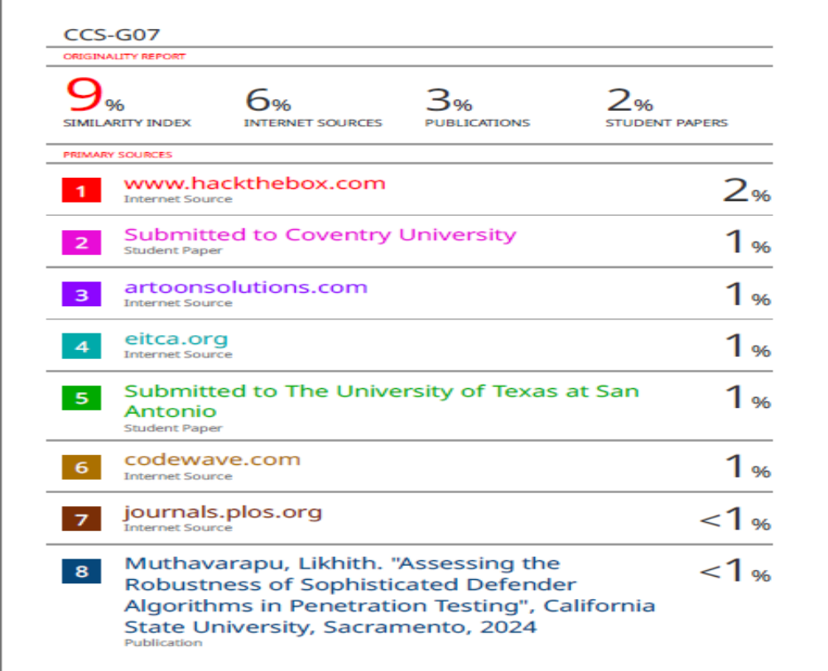
Plagiarism Check of Research Paper

Slide 5
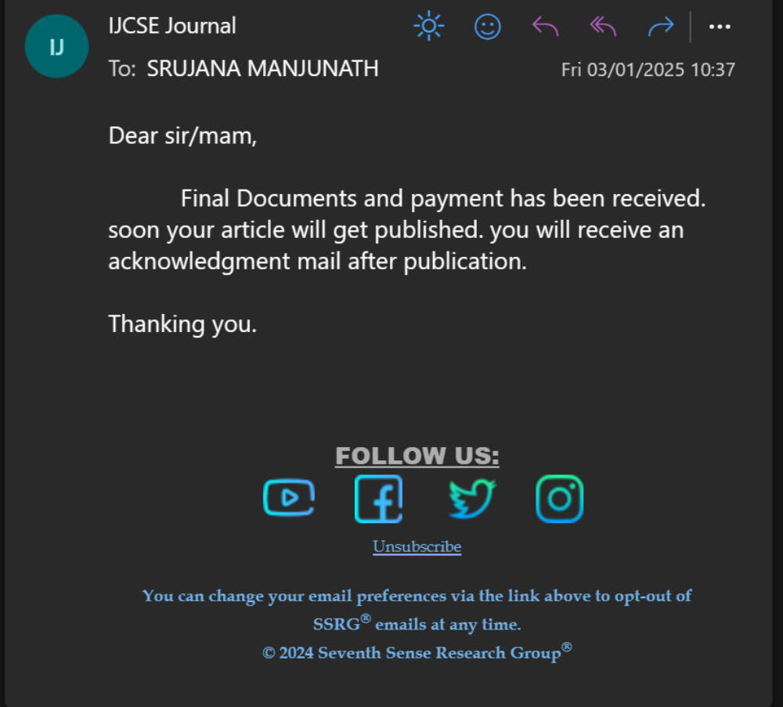
Paper Publication Acknowledgement

Slide 6
Timeline by Gantt Chart
FINAL REVIEW:
Report Hard Copy and Soft Copy submitted.
Plagiarism check of project report submitted.
Plagiarism check of research paper submitted.
Paper publication acknowledgement submitted.

Slide 7
Acknowledgement
We would like to express our sincere thanks to the supervisor, Dr. Sharmasth Vali Y, Associate Professor, Department of Computer Science Engineering for his morale boosting, meticulous guidance, co-operation and supervision throughout this project work.

Slide 8
Thank You !!!

